Slide 9
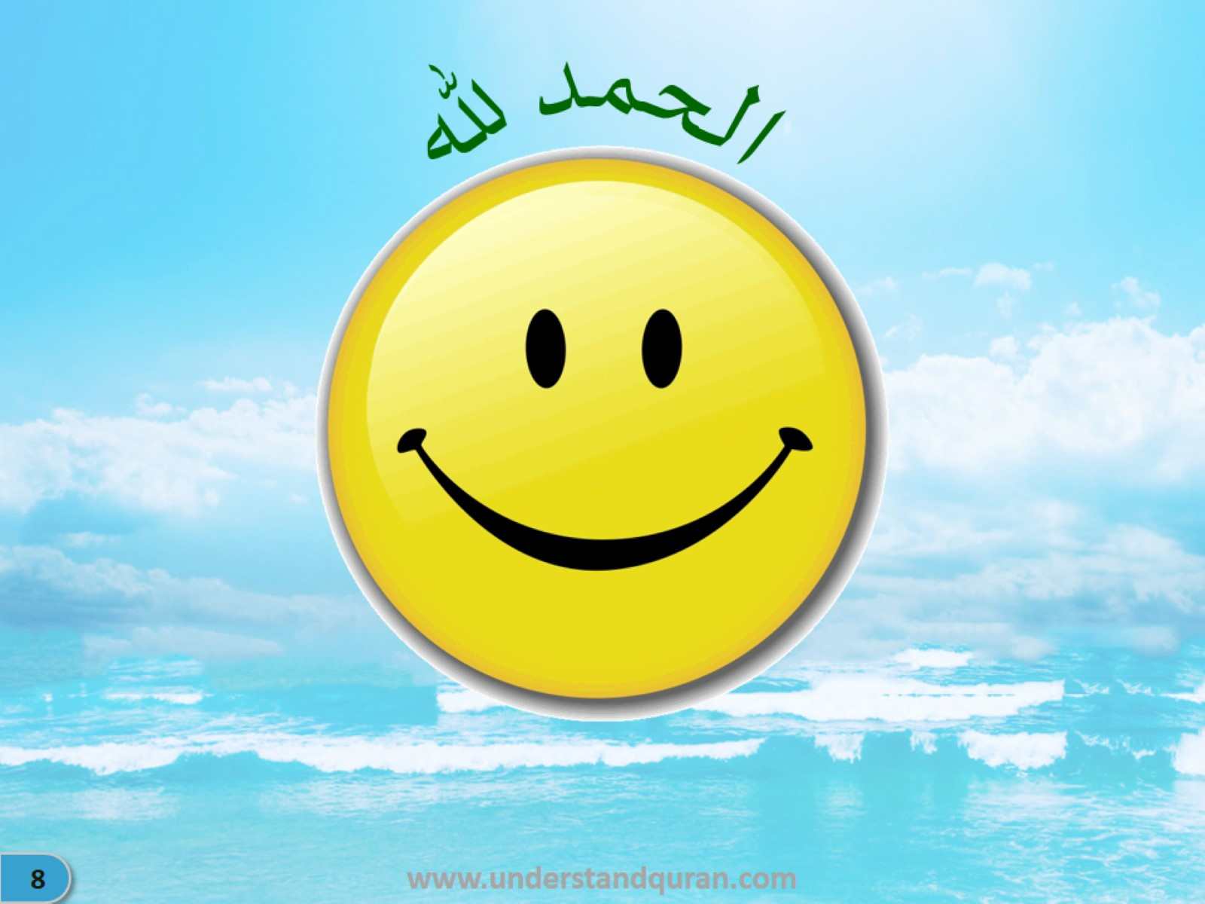

Slide 18
Active Voice

Slide 19
Passive Voice

Slide 20
Passive Voice – Examples (TPI: Rotate the hand & change the sounds)

Slide 21
Passive Voice – Examples (TPI: Rotate the hand & change the sounds)

Slide 23
Passive Voice

Slide 24
MashaAllah! You are ready for the next level. You will be amazed to see how easy the Qur’an is! Spend another 20 hours and you will have…

Slide 26
Don’t stop the wonderful journey of خَيْرُكُمْ مِنْ تَعَلَّمَ الْقُرْاٰنَ وَعَلَّمَه especially when the Qur’an will become so easy and when the course is also available.

